Slide 1
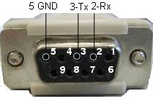
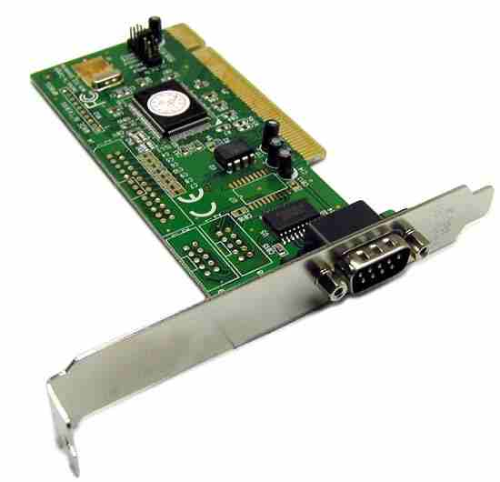
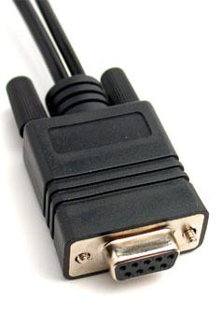
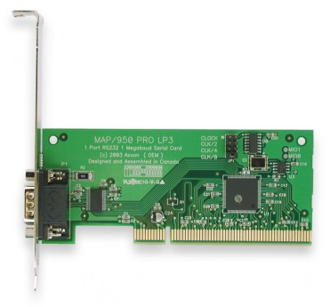
UART – RS-232
Nabil CHOUBA
http://nabil.chouba.googlepages.com

Slide 2
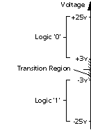
UART- RS-232
Universal Asynchronus Receiver/ Transmitter (UART)
• The UART input/output uses 0V for logic 0 and 5V for logic 1.
• RS232 signal levels :
- logic 0 for signal between 3V and 25V
- logic 1 for signal between -3V and -25V
• To convert between these voltages levels we need an additional integrated circuit (such as Maxim’s MAX232).

Slide 3
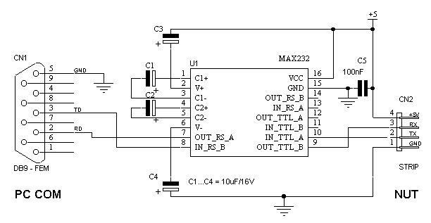
TTL 0/5 to RS-232 -12/12

Slide 4
Asynchronous vs. Synchronous
Asynchronous
- Receiver and transmitter have separate clocks, running at the same nominal frequency
- Synchronism achieved by detecting the start of each data word
Synchronous
- Receiver and transmitter synchronized by common clock (one clock to rule them all)
- Much faster than asynchronous communications

Slide 5
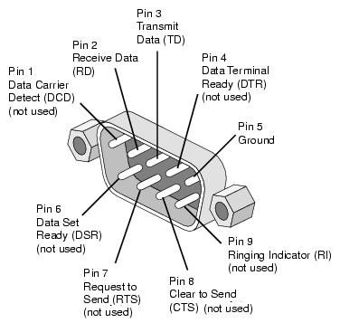
RS-232 Pin Assignment

Slide 6
Baud Rate
Typicall data rates: 75, 110, 300, 1200, 2400, 4800, 9600, 14400, 19200, 28800, 33600, 56000, 115000 and (rarely) 330000 baud.

Slide 7
Transmission Requirement
Before transmission begins, transmitter and receiver must agree on :
- Baut rate (75, 150, 300, 600, etc)
- 1, 1.5 or 2 stop bits
- 5, 6, 7 or 8 data bits
- even, odd or no parity

Slide 8
RS-232 Frame
Every RS-232 Frame consists of:
  1 start bit
  8 data bits
  1 stop bit
  (optional 1 parity bit)
[a]= 0x61 = 0110 0001
Start
D0
D1
D2
D3
D4
D5
D6
D7
P
Stop
1 1 1 1 0 1 0 0 0 0 1 1 0 0 1 1
T_{tx} = n .T_{clk}
T_{clk} = 1/25Mhz ,T_{tx} = 1/9.6Khz
n = T_{tx} /T_{clk} , n = 25000/9.6

Slide 9
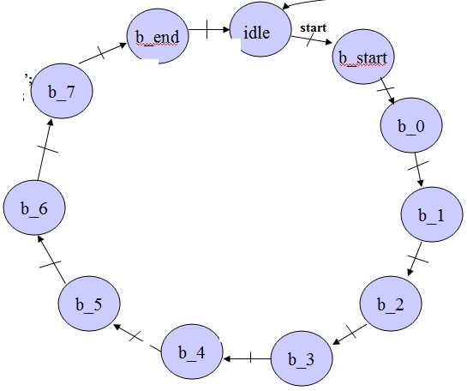
RTL View
Data_input
run_shift
b7
b6
b5
b4
b3
b2
b1
b0
shiftBit
(start) ‘0’
(stop) ‘1’
parity
00
01
10
11
load_shift
shift register
Flip
Flop
tx
seltx
xor
xor
xor
xor
xor
parity
xor
xor
soft_rst_brcount
State
Machine
Counter Bautrate
run_brcount
bautrate
start

Slide 10
Transmitter Tx
seltx <='10';
run_brcount <= ‘1’;
seltx <= '10';
soft_count_rst <= ‘1’
rst
b_stop
idle
start
bautrate
b_start
seltx <= '01';
run_brcount <= ‘1’;
Load_shift <= ‘1’
run_brcount <= ‘1’;
seltx <= ’11’;
bautrate
b_parity
bautrate
run_brcount <= ‘1’;
seltx <= ‘00’
b_0
bautrate
run_brcount <= ‘1’;
seltx <=‘00’;
b_7
Bautrate / run_shift <= '1'
Bautrate / run_shift <= '1'
b_1
run_brcount <= ‘1’;
seltx <=‘00’;
run_brcount <= ‘1’;
seltx <=‘00’;
b_6
Bautrate / run_shift <= '1'
Bautrate / run_shift <= '1'
b_2
run_brcount <= ‘1’;
seltx <=‘00’;
run_brcount <= ‘1’;
seltx <=‘00’;
b_5
Bautrate / run_shift <= '1'
b_4
b_3
Bautrate / run_shift <= '1'
Bautrate / run_shift <= '1'
run_brcount <= ‘1’;
seltx <=‘00’;
run_brcount <= ‘1’;
seltx <=‘00’;

Slide 11
VHDL CODE
comb_shift:process
(load_shift,data_shift_reg,run_shift,data,bautrate)
begin
data_shift_next<= data_shift_reg;
if load_shift ='1' then
data_shift_next <=data;
elsif run_shift ='1' and bautrate = '1' then
data_shift_next <= data_shift_reg(0) & data_shift_reg(7 downto 1);
end if;
end process;
shiftBit <= data_shift_reg(0);
parity<=data_shift_reg(0)xor data_shift_reg(1)xor data_shift_reg(2)xor data_shift_reg(3)xor data_shift_reg(4)xor data_shift_reg(5)xor data_shift_reg(6)xor data_shift_reg(7);
tx <= shiftBit when seltx ="00" else -- Data bit
'0' when seltx ="01" else -- Start bit
'1' when seltx ="01" else -- Stop bit
parity ;
cloked_process : process( clk, rst )
begin
if( rst='1' ) then
state_reg <= idle ;
counter_bautrate_reg <= (others =>'0') ;
data_shift_reg <= (others =>'0') ;
elsif( clk'event and clk='1' ) then
state_reg<= state_next ;
counter_bautrate_reg <= counter_bautrate_next;
data_shift_reg <= data_shift_next;
end if;
end process ;
bautrate <= '1' when counter_bautrate_reg = 5200 else
'0';
BR_COUNTER : process( counter_bautrate_reg, run_brcount, soft_rst_brcount,bautrate )
begin
counter_bautrate_next <= counter_bautrate_reg;
if soft_rst_brcount = '1' or bautrate = '1' then
counter_bautrate_next <= (others=>'0');
elsif( run_brcount = '1' ) then
counter_bautrate_next <= counter_bautrate_reg + 1 ;
end if ;
end process ;

Slide 12
VHDL CODE
--next state processing
combinatory_FSM_next : process(state_reg,start,bautrate)
begin
state_next<= state_reg;
case state_reg is
when idle =>
if start = '1' then
state_next <= b_start;
end if;
when b_start =>
if bautrate = '1' then
state_next <= b_0;
end if;
when b_0 =>
if bautrate = '1' then
state_next <= b_1;
end if;
when b_1 =>
if bautrate = '1' then
state_next <= b_2;
end if;
when b_2 =>
if bautrate = '1' then
state_next <= b_3;
end if;
when b_3 =>
if bautrate = '1' then
state_next <= b_4;
end if;
when b_4 =>
if bautrate = '1' then
state_next <= b_5;
end if;
when b_5 =>
if bautrate = '1' then
state_next <= b_6;
end if;
when b_6 =>
if bautrate = '1' then
state_next <= b_7;
end if;
when b_7 =>
if bautrate = '1' then
state_next <= b_parity;
end if;
when b_parity =>
if bautrate = '1' then
state_next <= b_stop;
end if;
when b_stop =>
if bautrate = '1' then
state_next <= idle;
end if;
when others =>
end case;
end process;

Slide 13
VHDL CODE
--controls output processing
combinatory_output : process(state_reg )
begin
run_brcount <= '0';
seltx <= "10"; --stop bit;
soft_rst_brcount <= '0';
Load_shift <= '0';
run_shift <= '0';
case state_reg is
when idle =>
seltx <= "10"; --stop bit;
soft_rst_brcount <= '0';
when b_start =>
seltx <= "01";
run_brcount <= '1';
Load_shift <= '1';
when b_0 | b_1 b_2 | b_3 |b_4 | b_5 |b_6 | b_7 =>
run_brcount <= '1';
run_shift <= '1';
seltx <= "00";
when b_parity =>
run_brcount <= '1';
seltx <= "11";
when b_stop =>
seltx <="10";
run_brcount <= '1';
when others =>
end case;
end process;

Slide 14
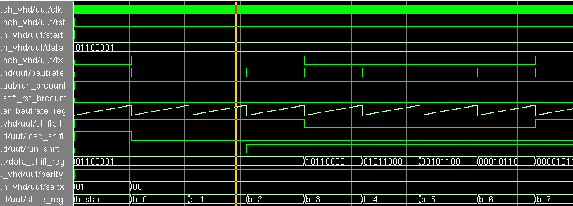
Simulation Result
(Mentor vsim)
Sending [ 0xC1 ] = 1100 0001

Slide 15
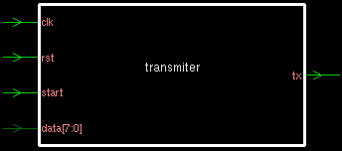
Synthesis Result
(designvision / synopsys)
Inferred memory devices in process
in routine transmiter line 61 in file
'/home/chouban/tp_vhdl/rs232/transmiter.vhd'.
===================================================================
| Register Name | Type | Width | Bus | MB | AR | AS | SR | SS | ST |
===================================================================
| data_shift_reg_reg | Flip-flop | 8 | Y | N | Y | N | N | N | N |
| state_reg_reg | Flip-flop | 4 | Y | N | Y | N | N | N | N |
| counter_bautrate_reg_reg | Flip-flop | 16 | Y | N | Y | N | N | N | N |
===================================================================

Slide 16
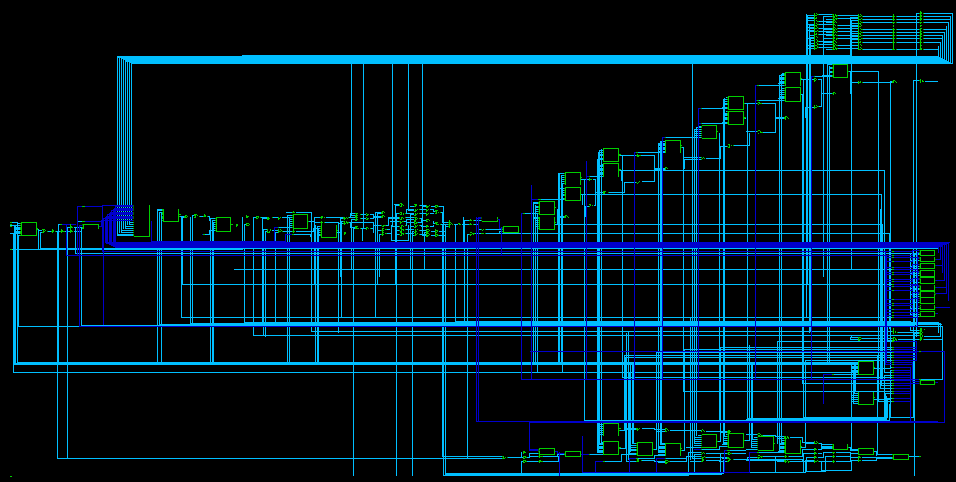
Synthesis Result
(designvision / synopsys/GTEC Library )
bautrate generation
Next State
State register
FSM output
Mux
seltx
Shift register

Slide 17
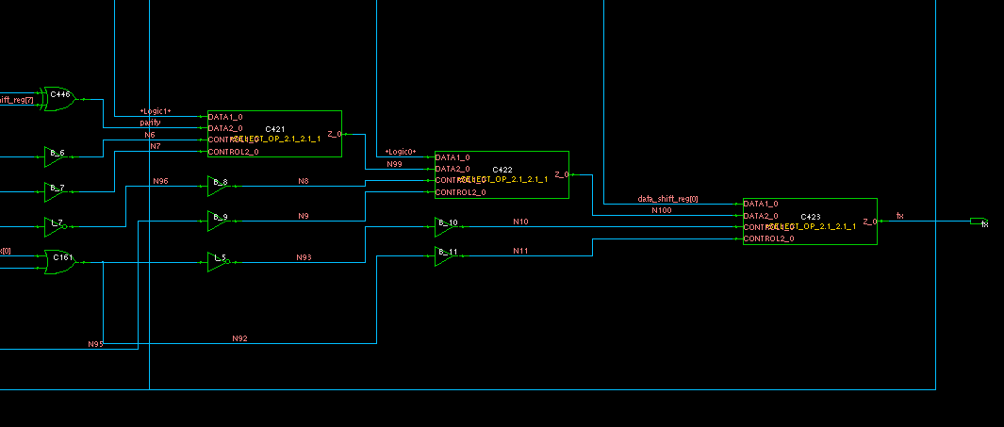
Mux – seltx
(designvision / synopsys)

Slide 18
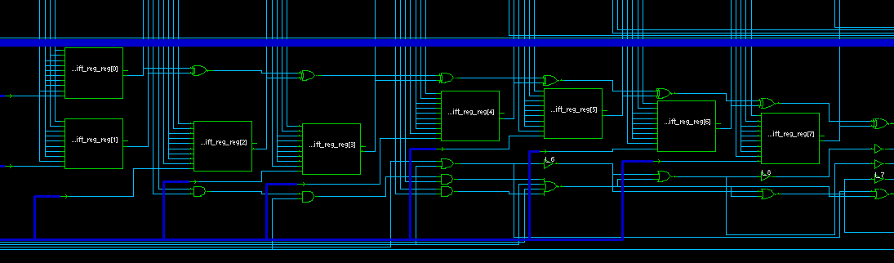
Shift register
(designvision / synopsys)

Slide 19
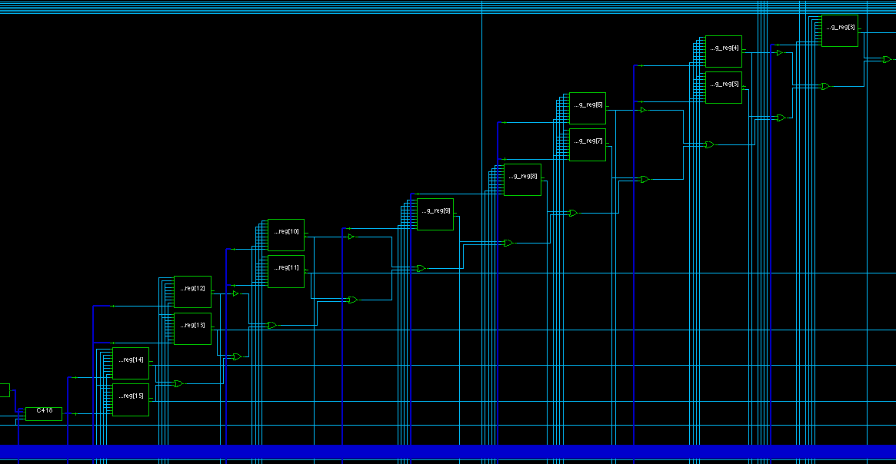
bautrate generation
(designvision / synopsys)

Slide 20
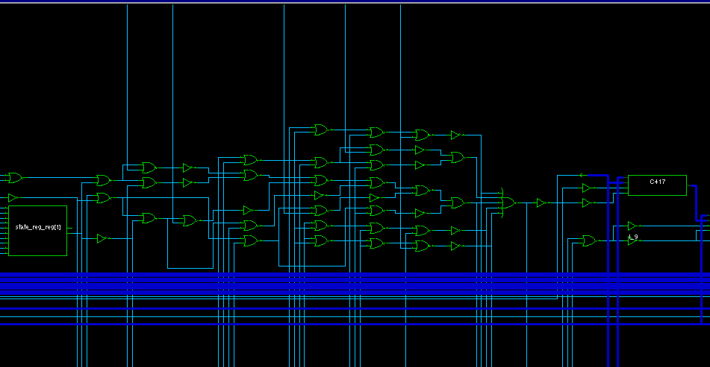
FSM output
(designvision / synopsys)

Slide 21
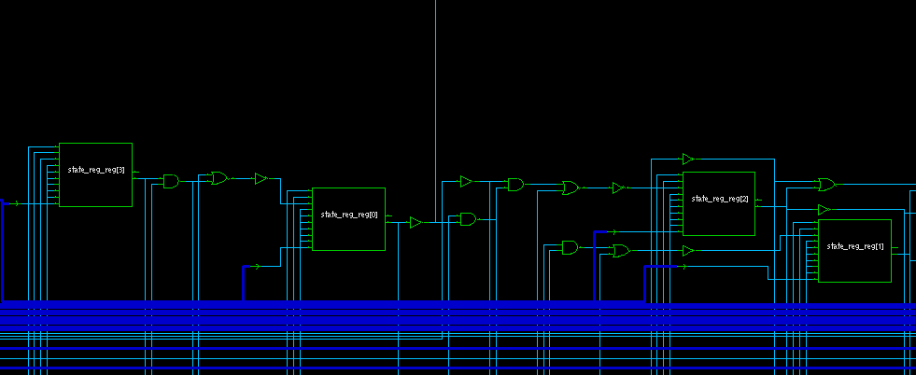
state : register & next
(designvision / synopsys)

Slide 22
Receiver sampling signal
bit 0
bit 2
Start bit
bit 1
8
16
16
16
The receiver uses the falling edge of the start bit to begin an internal timing circuit.
We use generally 16x the Bautrate to sample the received signal.
- The data should be most stable, approximately at the mid-position of each data bit.

Slide 23
RTL View
Data_output
b7
b6
b5
b4
b3
b2
b1
b0
save_data
rx
run_shift
b7
b6
b5
b4
b3
b2
b1
b0
shift register
Detect Start Bit
detect_start
Counter Bautrate
run_brcount
soft_rst_brcount
bautrate8
State
Machine
Data_ready

Slide 24
Receiver Rx
soft_rst_brcount<=‘1’
detect_start
Bautrate8
b_stop
idle
run_brcount <= ‘1’
b_start
run_brcount <= ‘1’
parity
Bautrate8 / save_data <='1';
data_ready <= '1';
Bautrate8
Bautrate8
b_7
b_0
run_brcount <= ‘1’
run_brcount <= ‘1’
Bautrate8 / run_shift <='1';
Bautrate8 / run_shift <='1';
b_6
b_1
run_brcount <= ‘1’
run_brcount <= ‘1’
Bautrate8 / run_shift <='1';
Bautrate8 / run_shift <='1';
b_5
b_2
run_brcount <= ‘1’
run_brcount <= ‘1’
Bautrate8 / run_shift <='1';
b_4
b_3
Bautrate8 / run_shift <='1';
Bautrate8 / run_shift <='1';
run_brcount <= ‘1’
run_brcount <= ‘1’

Slide 25
VHDL CODE
cloked_process : process( clk, rst )
begin
if( rst='1' ) then
state_reg <= idle ;
counter_bautrate_reg <= (others =>'0') ;
data_shift_reg <= (others =>'0') ;
data_save_reg <= (others =>'0') ;
rx_reg <= '0';
elsif( clk'event and clk='1' ) then
state_reg<= state_next ;
counter_bautrate_reg <= counter_bautrate_next;
data_shift_reg <= data_shift_next;
data_save_reg <= data_save_next ;
rx_reg <= rx_next;
end if;
end process ;
bautrate16 <= '1' when counter_bautrate_reg = 5200 else '0';
bautrate8 <= '1' when counter_bautrate_reg = 2600 else '0';
BR_COUNTER_GEN : process( counter_bautrate_reg, run_brcount, soft_rst_brcount, bautrate16 )
begin
counter_bautrate_next <= counter_bautrate_reg;
if soft_rst_brcount = '1' or bautrate16 = '1' then
counter_bautrate_next <= (others=>'0');
elsif( run_brcount = '1' ) then
counter_bautrate_next <= counter_bautrate_reg + 1 ;
end if ;
end process ;

Slide 26
VHDL CODE
comb_shift:process(data_shift_reg,run_shift,rx)
begin
data_shift_next<= data_shift_reg;
if run_shift ='1' then
data_shift_next <= rx & data_shift_reg(7 downto 1);
end if;
end process;
rx_next <= rx;
detect_start <= '1' when rx_next = '0' and rx_reg = '1' else
'0';
data_save_next <= data_shift_reg when save_data = '1' else
data_save_reg;
data <= data_save_reg;

Slide 27
VHDL CODE
when b_4 =>
if bautrate8 = '1' then
state_next <= b_5;
end if;
when b_5 =>
if bautrate8 = '1' then
state_next <= b_6;
end if;
when b_6 =>
if bautrate8 = '1' then
state_next <= b_7;
end if;
when b_7 =>
if bautrate8 = '1' then
state_next <= b_parity;
end if;
when b_parity =>
if bautrate8 = '1' then
state_next <= b_stop;
end if;
when b_stop =>
if bautrate8 = '1' then
state_next <= idle;
end if;
when others =>
end case;
end process;
--next state processing
combinatory_FSM_next : process(state_reg, detect_start, bautrate8, bautrate16)
begin
state_next<= state_reg;
case state_reg is
when idle =>
if detect_start = '1' then
state_next <= b_start;
end if;
when b_start =>
if bautrate8 = '1' then
state_next <= b_0;
end if;
when b_0 =>
if bautrate8 = '1' then
state_next <= b_1;
end if;
when b_1 =>
if bautrate8 = '1' then
state_next <= b_2;
end if;
when b_2 =>
if bautrate8 = '1' then
state_next <= b_3;
end if;
when b_3 =>
if bautrate8 = '1' then
state_next <= b_4;
end if;

Slide 28
VHDL CODE
when b_7 =>
run_brcount <='1';
if bautrate8 = '1' then
run_shift <='1';
end if;
when b_parity =>
run_brcount <='1';
when b_stop =>
run_brcount <='1';
if bautrate8 = '1' then
save_data <= '1';
end if;
when others =>
end case;
end process;
--output processing
combinatory_output : process(state_reg, detect_start, bautrate8, bautrate16)
begin
run_brcount <='0';
data_ready <= '0';
save_data <= '0';
soft_rst_brcount<='0';
run_shift <='0';
case state_reg is
when idle =>
soft_rst_brcount<=‘1';
when b_start =>
run_brcount <='1';
when b_0 =>
run_brcount <='1';
if bautrate8 = '1' then
run_shift <='1';
end if;
when b_1 =>
run_brcount <='1';
if bautrate8 = '1' then
run_shift <='1';
end if;
when b_2 =>
run_brcount <='1';
if bautrate8 = '1' then
run_shift <='1';
end if;
when b_3 =>
run_brcount <='1';
if bautrate8 = '1' then
run_shift <='1';
end if;
when b_4 =>
run_brcount <='1';
if bautrate8 = '1' then
run_shift <='1';
end if;
when b_5 =>
run_brcount <='1';
if bautrate8 = '1' then
run_shift <='1';
end if;
when b_6 =>
run_brcount <='1';
if bautrate8 = '1' then
run_shift <='1';
end if;

Slide 29
Testbench
clk <= not clk after 50 ns;
rst <= '0' after 150 ns;
tb : PROCESS
BEGIN
-- idle bit
rx <= '1';
-- wiat
wait for 100 * 5200 ns;
--stat bit
rx <= '0';
wait for 100 * 5200 ns;
for i in 0 to 7 loop
rx <= send_data(i);
wait for 100 * 5200 ns;
end loop;
-- party bit not implemented
rx <= '-';
wait for 100 * 5200 ns;
-- stop bit
rx <= '1';
wait for 100 * 5200 ns;
-- do nothing
wait for 100 * 5200 ns;
-- test if rw data = to sended data
assert (data = send_data)
report " data /= send_data"
severity Error;
-- end of simulation
wait for 1000ns;
assert (2=1)
report "end simulation"
severity note;
wait; -- will wait forever
end process;

Slide 30
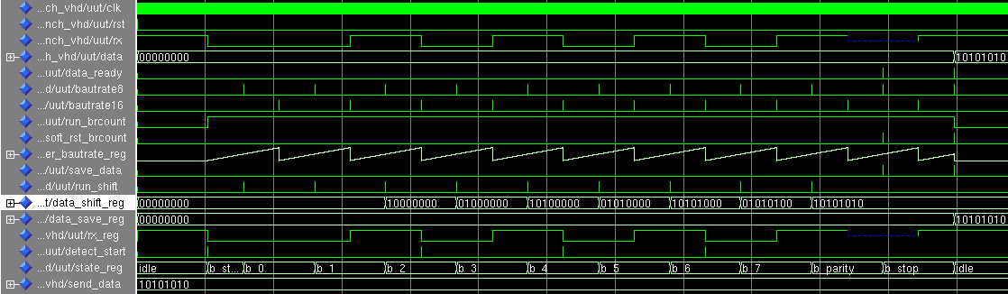
Simulation Result
(Mentor vsim)
Data resived : 10101010

Slide 31
Synthesis Result
(design_vision / synopsys/cmos65 Library )
Inferred memory devices in process
in routine resiver line 60 in file
'/home/chouban/tp_vhdl/rs232/resiver.vhd'.
=====================================================================
| Register Name | Type | Width | Bus | MB | AR | AS | SR | SS | ST |
=====================================================================
| rx_reg_reg | Flip-flop | 1 | N | N | Y | N | N | N | N |
| state_reg_reg | Flip-flop | 4 | Y | N | Y | N | N | N | N |
| counter_bautrate_reg_reg | Flip-flop | 16 | Y | N | Y | N | N | N | N |
| data_shift_reg_reg | Flip-flop | 8 | Y | N | Y | N | N | N | N |
| data_save_reg_reg | Flip-flop | 8 | Y | N | Y | N | N | N | N |
=====================================================================

Slide 32
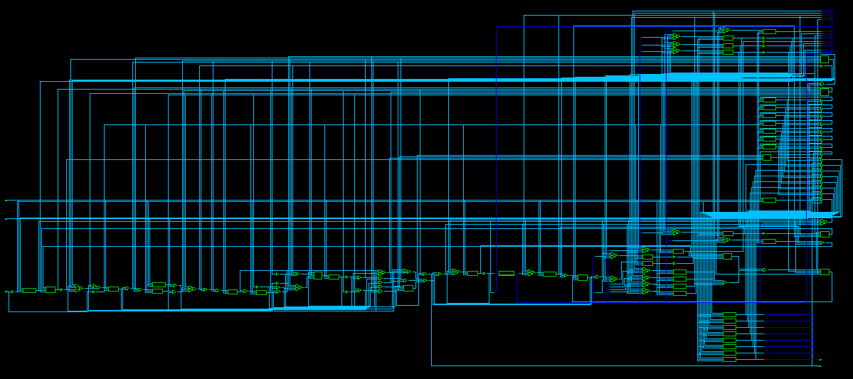
Synthesis Result
(design_vision / synopsys/cmos65)
shift
register
Counter Bautrate
State Machin
save register

Slide 33
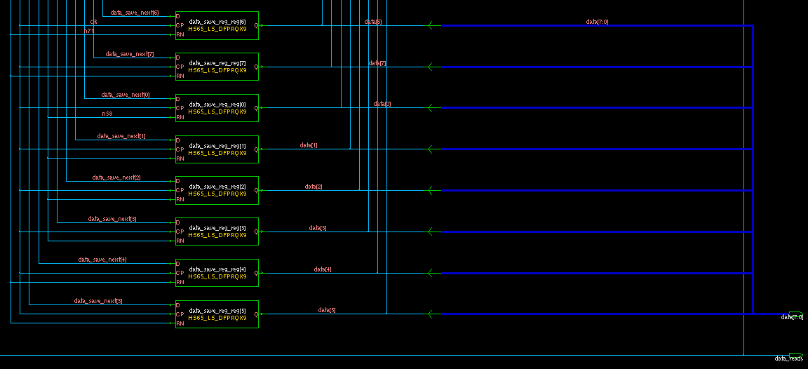
Save data register & logic /cmos65

Slide 34
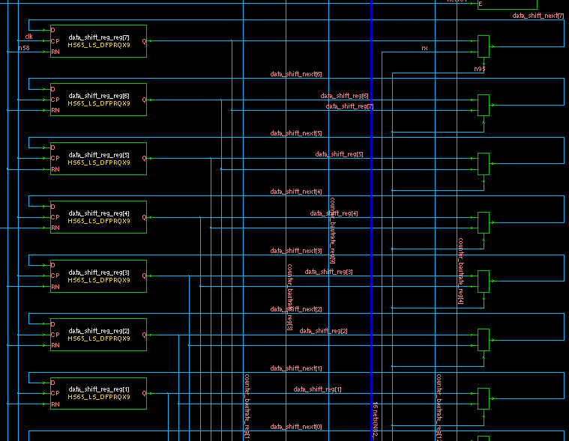
shift data register & logic /cmos65

Slide 35
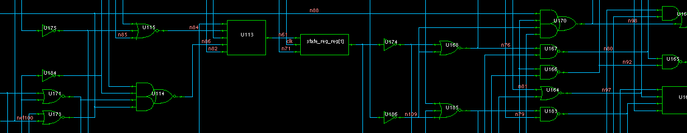
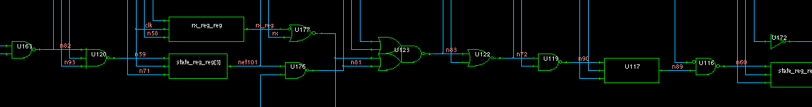
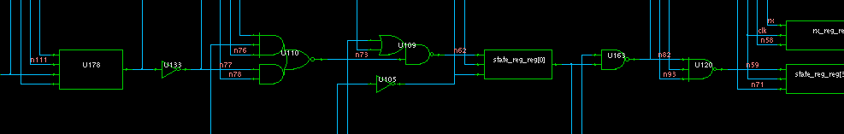
State Machin /cmos65

Slide 36
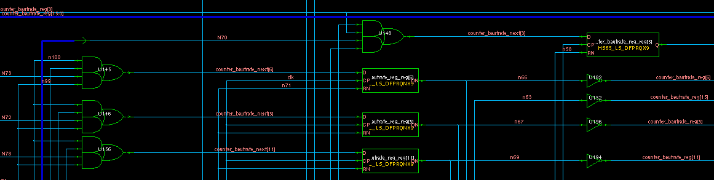
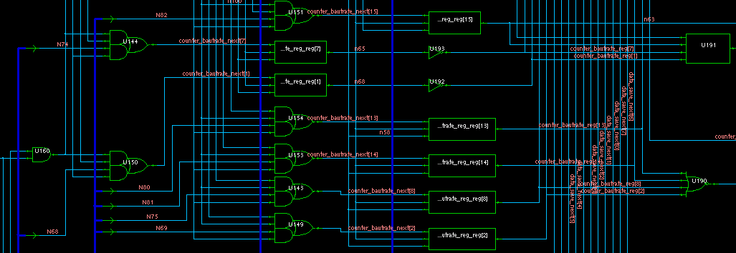
Counter Bautrate /cmos65

Slide 37
Report : area (cmos65)
****************************************
Report : area
Design : resiver
Version: Z-2007.03-SP5-1
Date : Wed May 6 12:20:00 2009
****************************************
Library(s) Used: CORE65
Number of ports: 12
Number of nets: 148
Number of cells: 130
Number of references: 23
Combinational area: 364.519990
Noncombinational area: 384.799986
Net Interconnect area: undefined (Wire load has zero net area)
Total cell area: 749.319946
***** End Of Report *****

Slide 38
Report : Power (cmos65)
****************************************
Report : power
-analysis_effort low
Design : resiver
Version: Z-2007.03-SP5-1
Date : Wed May 6 12:21:43 2009
****************************************
Global Operating Voltage = 1.1
Power-specific unit information :
Voltage Units = 1V
Capacitance Units = 1.000000pf
Time Units = 1ns
Dynamic Power Units = 1mW (derived from V,C,T units)
Leakage Power Units = 1pW
Cell Internal Power = 1.2396 uW (77%)
Net Switching Power = 367.3567 nW (23%)
---------
Total Dynamic Power = 1.6070 uW (100%)
Cell Leakage Power = 13.1999 uW

Slide 39
Report : reference
eference Library Unit Area Count Total Area Attributes
-----------------------------------------------------------------------------
HS65_LS_AND2X4 CORE65xxxx 2.600000 1 2.600000
HS65_LS_AO12X9 CORE65xxxx 3.640000 1 3.640000
HS65_LS_AO22X9 CORE65xxxx 4.160000 32 133.119995
HS65_LS_AOI22X6 CORE65xxxx 3.640000 1 3.640000
HS65_LS_AOI32X5 CORE65xxxx 4.160000 2 8.320000
HS65_LS_BFX9 CORE65xxxx 2.080000 3 6.240000
HS65_LS_CBI4I1X5 CORE65xxxx 3.640000 1 3.640000
HS65_LS_DFPRQNX9 CORE65xx 10.400000 12 124.799995 n
HS65_LS_DFPRQX9 CORE65xxx 10.400000 25 259.999990 n
HS65_LS_IVX9 CORE65xxxx 1.560000 20 31.199999
HS65_LS_NAND2AX7 CORE65xx 3.120000 1 3.120000
HS65_LS_NAND2X7 CORE65xxx 2.080000 2 4.160000
HS65_LS_NAND3X5 CORE65xxx 2.600000 3 7.800000
HS65_LS_NAND4ABX3 CORE65x 3.640000 2 7.280000
HS65_LS_NOR2X6 CORE65xxxx 2.080000 5 10.400000
HS65_LS_NOR3AX4 CORE65xxx 3.640000 1 3.640000
HS65_LS_NOR3X4 CORE65xxxx 2.600000 5 13.000000
HS65_LS_NOR4ABX2 CORE65xx 3.640000 6 21.840001
HS65_LS_OAI13X5 CORE65xxx 3.640000 1 3.640000
HS65_LS_OAI21X3 CORE65xxx 2.600000 2 5.200000
HS65_LS_OAI212X5 CORE65xxx 4.160000 2 8.320000
HS65_LS_OAI222X2 CORE65xxx 5.200000 1 5.200000
resiver_DW01_inc_0 78.519997 1 78.519997 h
-----------------------------------------------------------------------------
Total 23 references 749.319976

Slide 40
UART : Enhancement
add FIFO for : data received
add FIFO for : data to transmit
=> Use of dual port ram (fifo_full/fifo_empty)
programmable
- Bautrate : 75, 150, 300, 600, etc
- 1, 1.5 or 2 stop bits
- 5, 6, 7 or 8 data bits
- even, odd or no parity
=> Add configurable register, add command signal

Slide 41
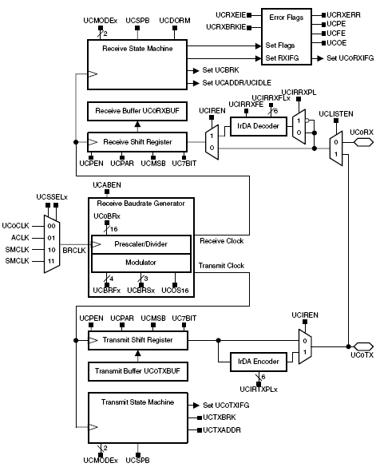
Exemple of UART on µc
7- or 8-bit data with odd, even, or non-parity
Independent transmit/receive shift registers
Separate transmit and receive buffer registers
LSB-first or MSB-first data transmit and receive
Receiver start-edge detection for auto-wake up from LPMx modes
Programmable baud rate with modulation for fractional baud rate support
Status flags for error detection and suppression
Independent interrupt capability for receive and transmit
* TI / MSP430

Slide 42



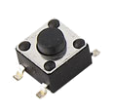
FPGA over-all Test
receiver
data
rx
Data_ready
PC
data=[a]= 0x61
transmitter
tx
debounce
start
PC
When buttons is pushed , PC receive : [a]= 0x61
PC send data to FPGA : data are displayed on leds
=> Use HyperTerminal to send and receive data

